Slide 1
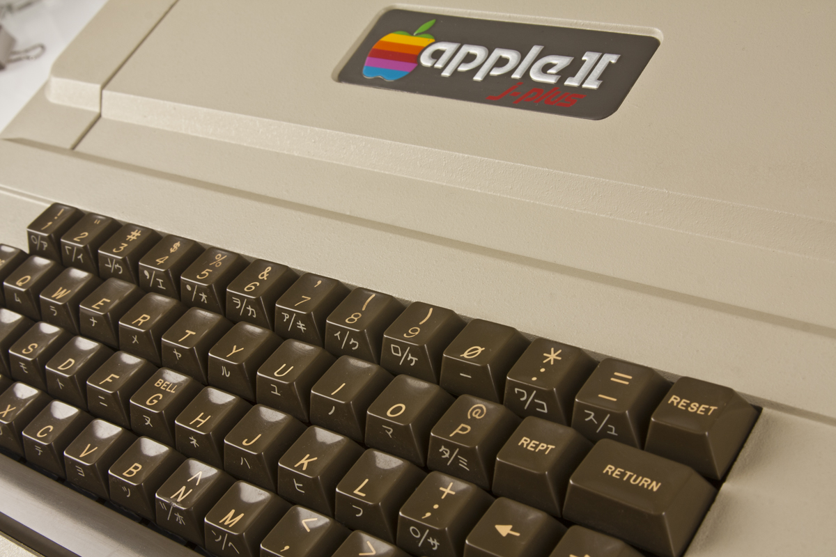

Joel Viney Programmer
https://github.com/JoelViney
Developing for 30+ years
Professionally 20+ years
Test Driven 15+ years
Notes:
30y Apple 2c | Café Manager | 20y Professionally | C# Beta | 15y TDD
Joke on Profile
Apple 2c - Started programming an apple 2c 30ish years ago (Microsoft Basic)
Café Manager - 26 I was the night manager of a café and programming in my spare time
Realised I had it the wrong way around, so started programming and making coffee in my spare time
Programmed C and some crappy languages that I wont mention
Released my first C# application when it was still in Beta
Apart from the odd venture into the world of Java I have been programming dotNet since then.
My first introduction to test driven development was about 15 years ago…

Slide 2

Test Driven Development (TDD)
The Awesome Golden Hammer
Notes:
Verbatim
Question? Who writes Tests?
Question? Who does TDD?
TDD?: Write Test before Write Production Code…
Who here writes tests at work?
Who here does or has done TDD at work?
What is Test Driven Development? Its pretty simple, you write the tests before you write the production code.

Slide 3
Test Driven Development
Different types of tests:
Integration Test
Behaviour Driven Tests
Load Testing
Unit Tests
Notes:
Integration - Database, API, Socket
Behaviour – Human readable tests… User Stories, End to End. E.g. Order for 3 pencil, 7 pen > Invoice
Load – Performance, External Resource, Real Life, API, Database
Unit – Testing a small ‘bit’ of code
Integration tests – hit a database, call an API, tests sockets, etc…
Behaviour driven tests – Using ‘User Stories’ which end up as testing the system end to end. I place an order, I buy 3 pencils, 7 pens what does my invoice look like?
Load Testing – Generally testing an external resource to see how well it runs
Unit Tests – This is what test driven produces, hopefully by the end of this presentation we will have that sorted.

Slide 4
A brief history
Extreme Programming Explained: Embrace Change.
- Ken Beck, Martin Fowler – 1999 Addison-Wesley.
Notes:
1999 Ken Beck & Martin Fowler | Rediscovered TDD
Popular early 2000
Backlash (TDD Easy to understand and hard to master)
So in 1999 Ken Beck and Martin Fowler released a book, Ken Beck claimed to have rediscovered TDD
It became very popular in the early 2000s,
then had a bit of a backlash which it still suffers from today because TDD is easy to understand but hard to master.

Slide 5
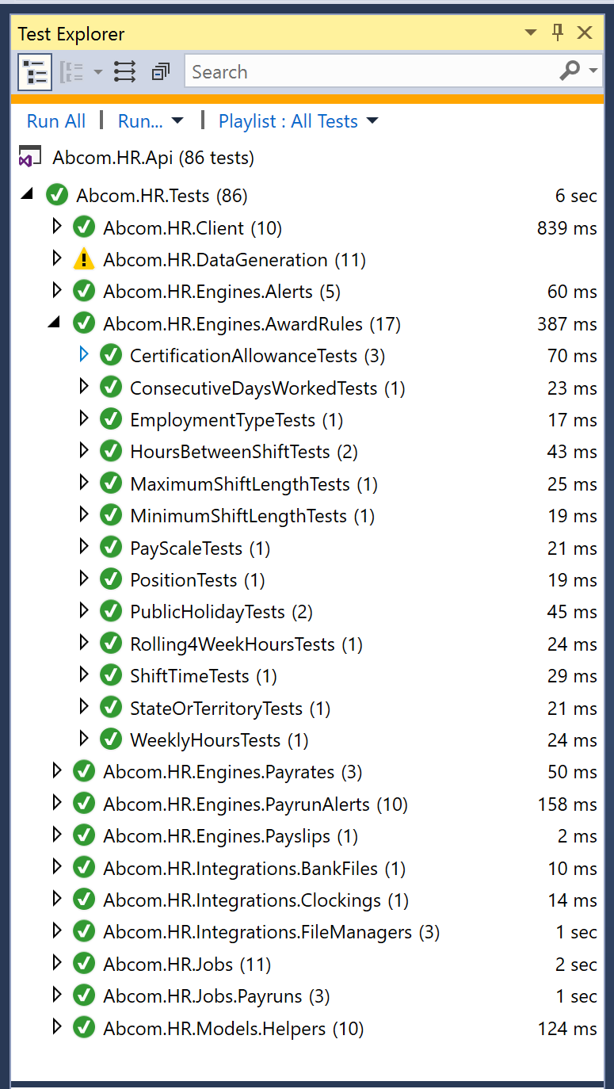
When TDD really works
Not Really a Golden Hammer…
Examples of it working:
Point of Sale
Payroll System
Low Hanging Fruit
Complex Problems
Easily Isolated
Notes:
PLOT TWIST: IMHO TDD Not Golden Hammer | Low Hanging Fruit | Some good examples
POS System – Adult | 4 Programmers | 1 Full Time | 26000 Combinations | Rewrite | 1000 exhaustive tests | Messy Code | Shipped It | 1 Year
Mc Donald’s Payroll – Retail Award, McDonalds Award | 100 page Document | 13 Rules | 86 Tests | TDD Engine | Boss 5-10 years? | 6 months
Html Templating Engine | IF | LOOPS
Workflow Engine
Writing Authentication System
Pattern | TDD Shines | Complex Problems | Easily Isolated
So How to do TDD?
IMHO TDD is not really a golden hammer. But for some problems it can provide an amazing result.
[TODO: Could expand this into 2 more slides]
In my career I have 2 examples of when TDD really paid off.
POS system.
One programmer pretty much employed full time to take care of the pricing module of the POS system.
Specced it out in a week with the principle and the development manager
Spent a week working out how the rules effected the final outcome, and that there were 26000 combinations
Wrote some tests, exhaustive tests (I wouldn’t do it that way now)
Deleted all the production code.
Rewrote it in 2 hours.
I left, 1 year later there was 1 bug that was found as we didn’t quite get the analysis correct. The code was 100% right.
Payroll System.
McDonalds Award.
100 page documents.
Reduce it to 13 simple rules.
Wrote tests for each rule in true TDD, quickly expanded into a rules engine.
86 Tests
Spent 3 months telling the boss I had solved the problem he still didn’t believe me.
These kind of complex problems is where test driven can really shine.

Slide 6
How to do TDD
Write a test
Run the test, see it fail
Write the code
Run all tests, see them pass
Refactor
Repeat
Notes:
Verbatim | I will explain

Slide 7
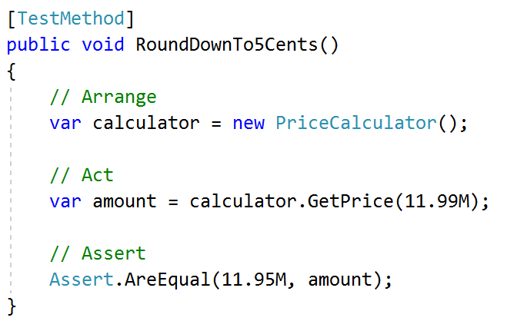
1. Write a test
Your trying to tell a story.
The method name should describe what your testing.
// Arrange
Setup what needs to be done
KISS: Aim for minimal setup
// Act
One line of code!
// Assert
Prove it works
Aim for 1 asset per test*
Notes:
Arrange = 8 year old story, Price Calculator KISS, Emergent Design. Shopping Cart
Act = 1 line
Assert = Aim for 1 assert per test
Imagine your trying to explain your application broken down into segments to an 8 year old. Kind of like user stories, but simpler.
Arrange: So KISS. As you can see a point of sale system’s price calculator isn’t this simple.
Act: One line of code, make it obvious to the reader what you are testing.
* Assert: Aim for 1 assert per test, this is the rule, but for simplicity rules can be broken.

Slide 8
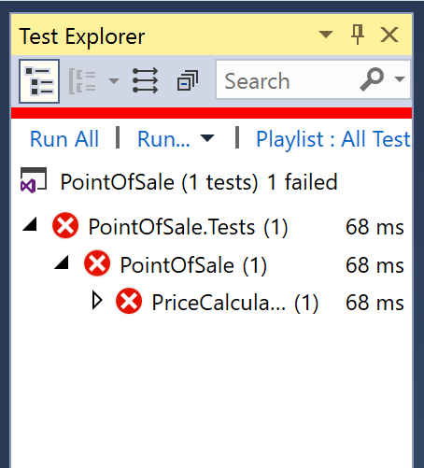
2. Run the test, see it fail
You need to do this step to assure that the test fails.
The test must fail…
Notes:
Verbatim
What are you testing? Sometimes there is an exception.
Official Guide all tests.
If the test doesn’t fail, what are you testing? Do it this way to start…
But as you get more advanced, sometimes it’s easier to write the algorithm then backtrack and assure you have the appropriate tests. This is dangerous and you could end up with code you don’t need.
The “official guide” recommends running all tests. If you had to change production code to write the test, then sure run all tests.

Slide 9
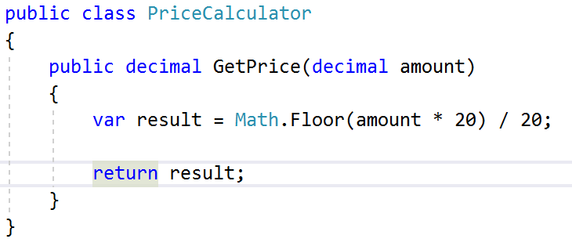
3. Write the code
Write just enough code to make the test pass.
YAGNI
Notes:
Smart Arse 11.95
YANGI: Only write enough code to make the test pass.
But, don’t be a smart arse and just return 11.95… It will just create more work. E.g. you will need to write a 2nd test to prove that the method doesn’t just return 11.95.
You will find it done this way in examples, but I think it is a slight miss-interpretation of the original ideas. But when your starting out, do it this way.

Slide 10
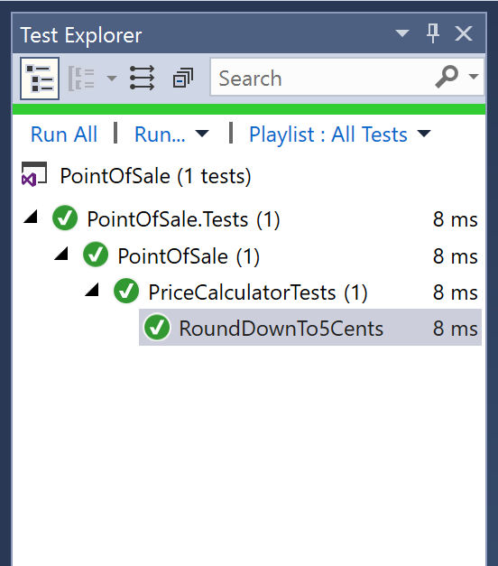
4. Run all tests, see them pass
You might have broke another test when writing the code to make this test past
Notes:
Run All, Safety Net
This is your safety net, and the real power behind tests driven… if you changed the code you *might* have broke something else…

Slide 11
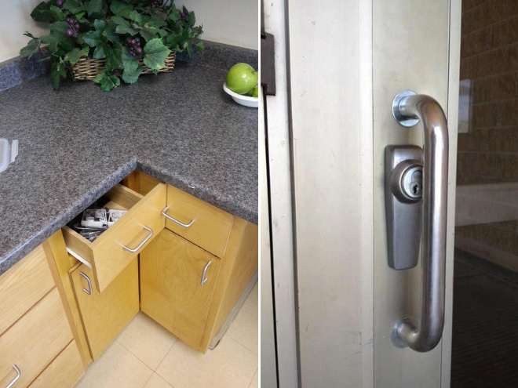
5. Refactor
Code Smells. You will know when it’s time to refactor, your code will start to smell.
You can refactor! You have tests to prove that the code will work. Go to town.
Notes:
Code Smells - Verbatim 1. Arrange gets Hairy, Simpler way to describe problem | Add a Factory, Fluid Extensions etc..
Refactor - Verbatim 2. Refactor. Safety Net | Production code wont break
This will happen. Your // Arrange code will get hairy.
Or due to emergent design your new test will introduce a new object or you will think of a simpler way of describe the problem.
So Refactor. You have all those tests behind you which means you can go sick and rewrite stuff to your hearts content.

Slide 12
Repeat
Write a test
Run the test, see it fail
Write the code
Run all tests, see them pass
Refactor
Repeat
Notes:
Verbatim

Slide 13
Best Practice
Arrange – KISS. You are telling a story to an 8-year-old.
Act - One action per act
Assert – One Assert per test… in theory
DAMP not DRY – Each story is its own story
Tests Matter - Treat Test code like you would production code. Maintain and refactor it.
Keep Tests Short – KISS, Use Fluid Extensions
Writing code that only contributes to a passing test… YANGI. In theory
Continuous integration
Notes:
Arrange = KISS, 8 year old
Act = 1 Assert Always
Damp = You cant expect the 8 year old to have read the prequel.
Tests Matter = More Important than Production Code?
Writing Code = In Theory. Null Checks, Extreme Exception cases (old days 80% coverage)
KISS
YANGI
CI, Check-in Guard
To reiterate.
Arrange: Keep it simple, you are telling a story, imagine your trying to describe something to an 8 year old.
Act: One Act per test, you shouldn't break this rule
Assert: One assert per test, because you are testing 1 thing and proving 1 thing is correct….But you can break this rule if it helps simplify your tests and lowers your code maintenance.
Damp – Not dry. We need to know why Jack and Jill went up the hill. Don’t start with Something happened in a different story (see reference) and Jill fell down and broke her crown.
Tests Matter - Tests are worth as much as production code, in fact I would argue your tests are worth more. They describe how the application should work.
Use Fluid Extensions: I will get to this later

Slide 14
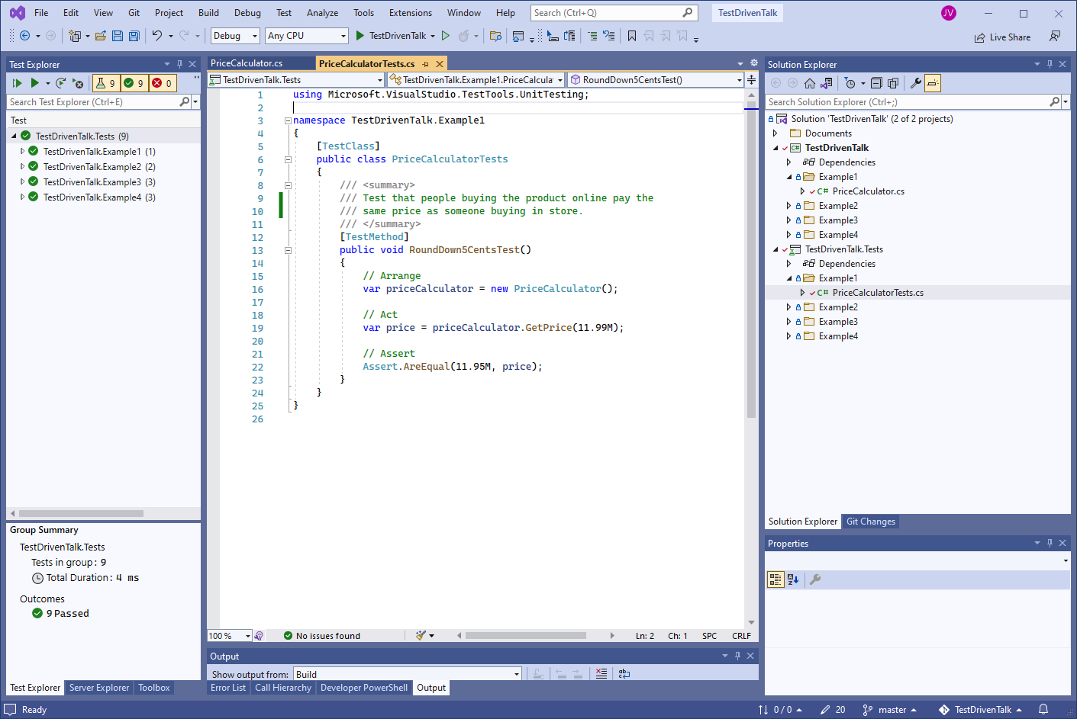
TDD Examples…
Notes:
Some Examples | Trivial = doesn’t highlight TDD | Too Complex = struggle to grasp | Start Trivial -> Get Complex
Okay, lets go through some simple examples. And then start to slowly add some business logic.
The problem with what I am about to show you is… You need to make trivial examples so people can follow, but it doesn’t really highlight TDD very well. And if you get too complex, it starts to highlight TDD but is too hard to really follow.

Slide 15
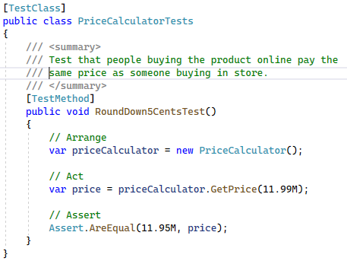
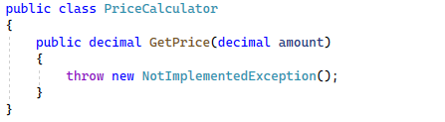
TDD Example #1 – Rounding
Notes:
Pricing Calculator | Price is 11.99 | Buy Online == Same Price as In Store
Comment = DiscreteBusiness
Run Test -> Fail

Slide 16
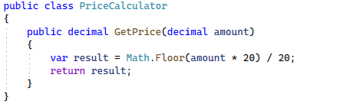
TDD Example #1 – Rounding
Notes:
Simple Implementation | Run Test Pass

Slide 17
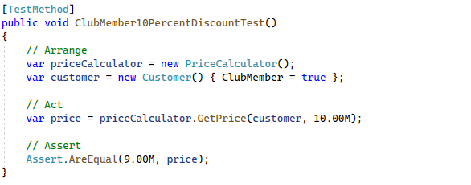
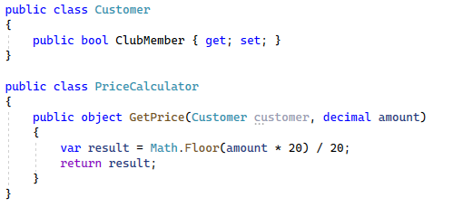
TDD Example #2 – Club Member
Notes:
Loyalty Card / Membership | 10% discount Customer Object
Run Test | Fail

Slide 18
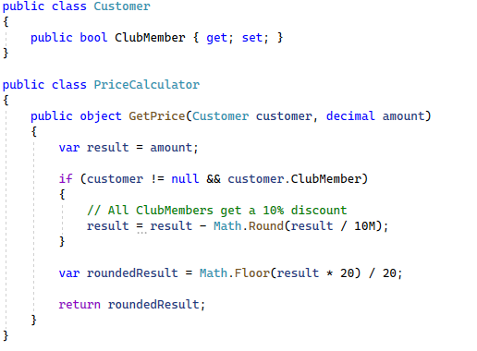
TDD Example #2 – Club Member
Notes:
Add Code to Handle Club Member | Pass Test

Slide 19
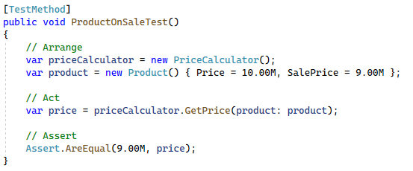
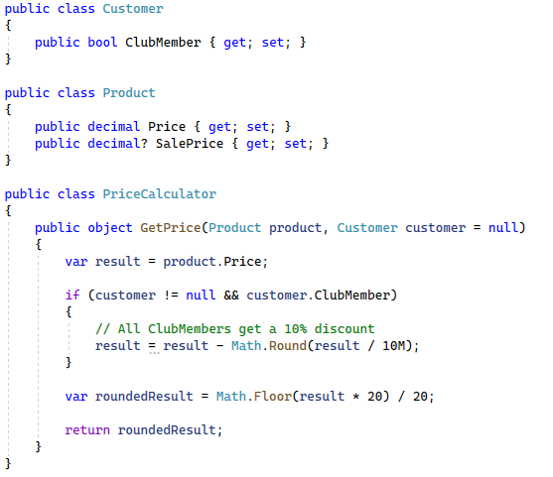
TDD Example #3 – Sale Price
Notes:
Put Products on Sale
Product Object | Refactor GetPrice | Run Test = Fail

Slide 20
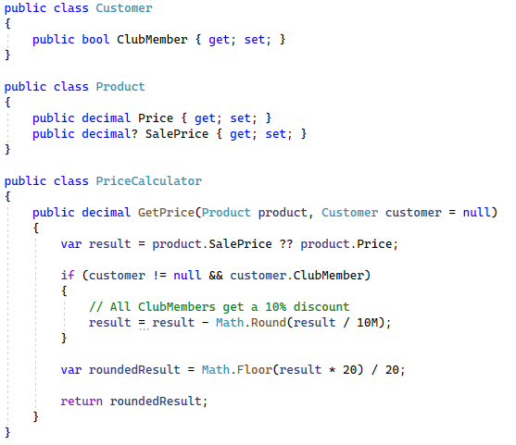
TDD Example #3 – Sale Price
Notes:
So Account for Sale Price | Not Realistic = Sales are for limited time

Slide 21
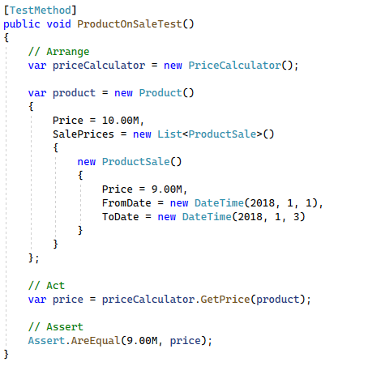
TDD Example #4 – Sales by Date
Notes:
So.. Lets add Sales to the Product | Test
Dates will be outdated… So Mock|Stub Time

Slide 22
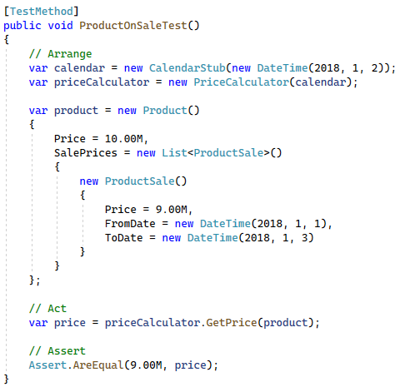
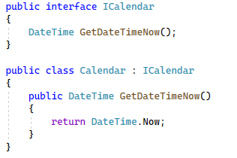
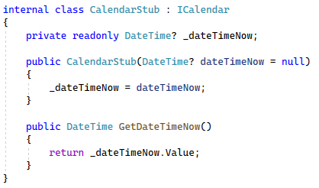
TDD Example #4 – Sales by Date
Notes:
ICalendar & Calendar Stub
But the Test is Getting Lengthy…

Slide 23
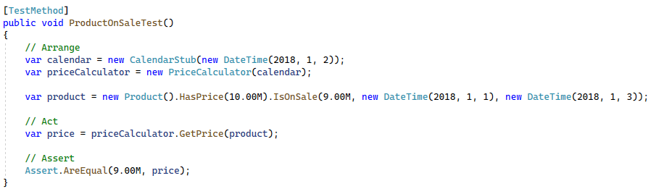
TDD Example #4 – Sales by Date
Notes:
Fluid Extensions | 8 Year Old

Slide 24
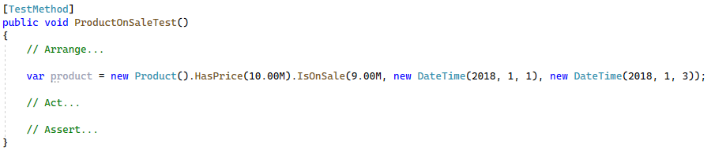
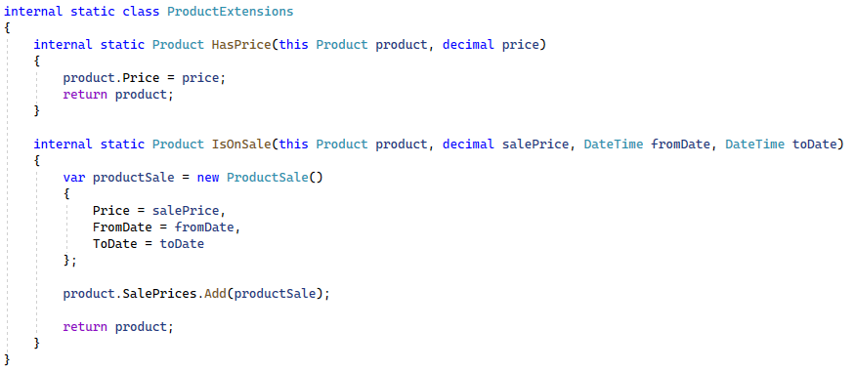
TDD Example #4 – Sales by Date
Notes:
Implementation

Slide 25
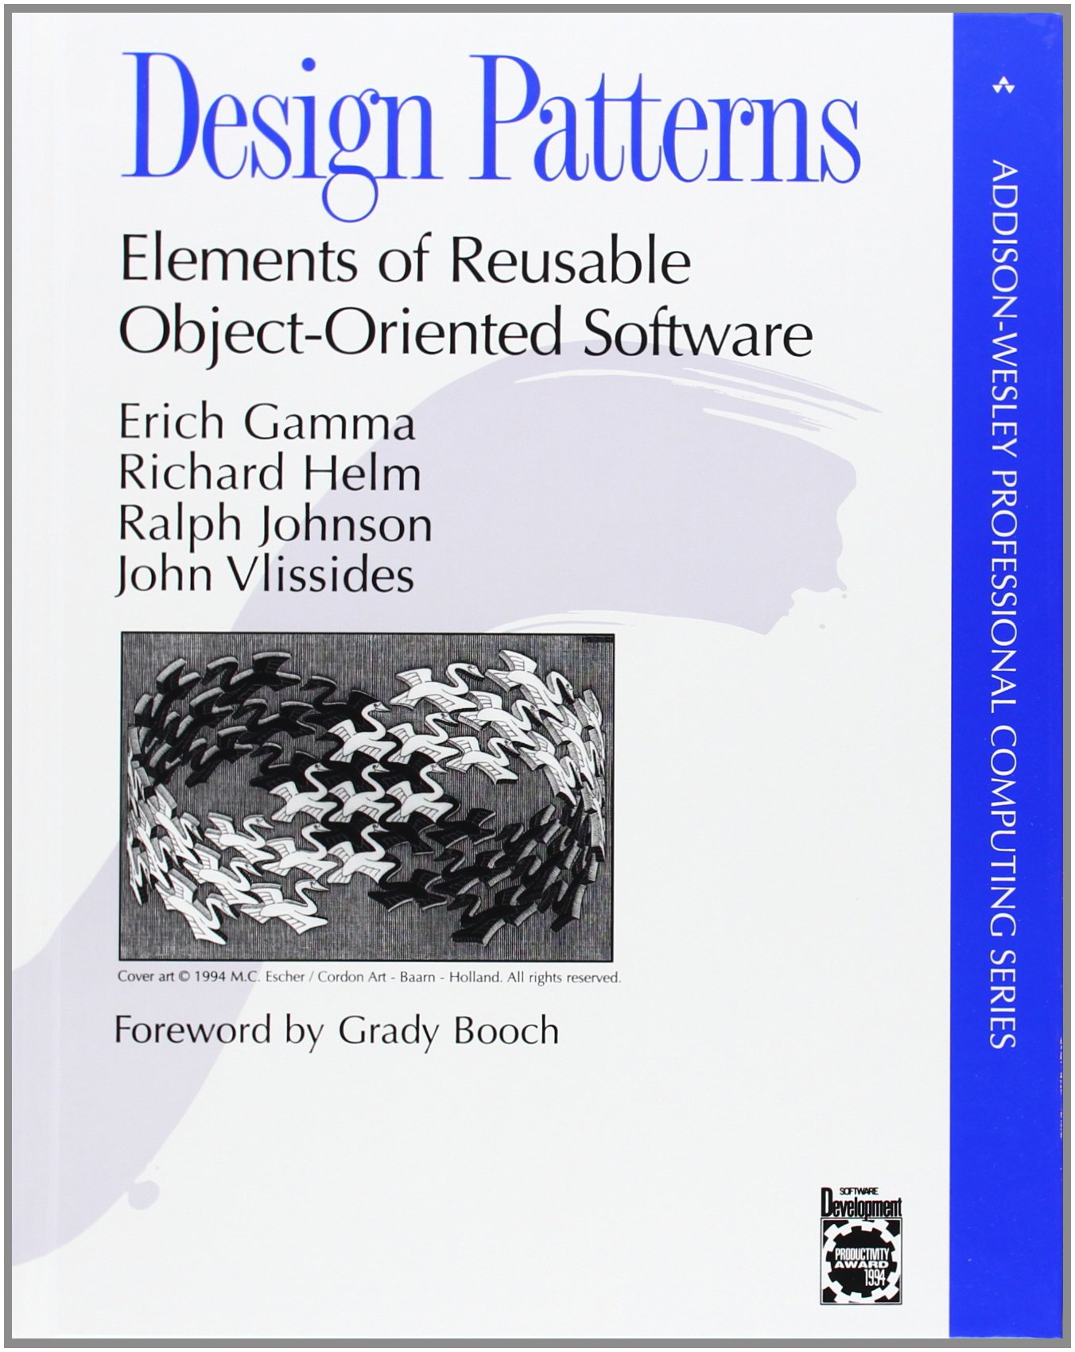
Emergent Design
“There’s an approach to software development whereby we evolve the low-level design of the code incrementally. As it takes shape, the code itself “tells” us how it should be designed, if we would but listen.”
– Some Guy on the Internet
Notes:
Over over-engineered: Reach for == CORBA, Message Queues, The Cloud, Microservices.
Programmers Complex Solutions
Bare Minimum | In Example: Didn’t Start With An Order… Start at Beginning == Emergent Design..
Baby Bathwater ( Factory or Service Layer ) With Caution | Knowing Patterns | Find Right Solution | Balance == hard.
Gang of 4 Book, The Other Book
This is a hard one to describe.
I am sure all of you have worked with over-engineered solutions before.
Some fun warning signs: CORBA, Message Queues, The Cloud, Microservices. or pretty much anything your manager has said since you started programming…
On top of that programmers bless their soles tend to think up complex solutions to often simple problems.
So the idea here is your focusing on the bare minimum required to get the code working.
But, don’t throw the baby out with the bath water, if you know your going to need a Factory or a Service Layer, a Repository or some other design pattern. Implement it early, it will start to smell if it isn’t right. This will come with experience, so start small.
The simple fact that you can refactor and know you wont be breaking code means you can start simply and then evolve the solution as needed.

Slide 26
Benefits
Tests document your application
Tests simplify your code / interfaces
Emergent Design
You can refactor without worrying about breaking stuff
This is a game changer
Notes:
Verbatim

Slide 27
Anti-patterns / Traps to avoid
Tests depending on other tests
Slow running tests
Unit Tests that integrate with a
Database, Testing CRUD, File System, API / Controller, Access the network
Focusing on testing methods and not requirements
Testing private methods
Mocking libraries
(Test your external interfaces instead)
Writing the minimum amount of code to make a test pass
“Would I code day-to-day with steps this small? No.“ – Kent Beck
Notes:
Dependent Tests = Cause you pain
Slow / Unit Tests = Wont be run (Keep them separate)
Private Methods | Mock -> Check Database }} expand
Methods | Focus Tests on Functionality
“Would I code day-to-day with steps this small? No.“ – Kent Beck - TDD by example pdf
If you know the design is, do it. Miss-interpretation of original intent.
Tests should be independent and can be run in any order and in parallel.
Tests should be fast, or people won’t run them. People won’t run them, they will break stuff.
Unit Tests that integrate…. Don’t get me wrong there is value for integration tests, but they should be kept separate.
Testing private methods: You are testing the external interfaces. Create something, Get it, Delete it, Assure its deleted.
Don’t focus on what method you need to test next. Focus on the requirements, or micro bits of business logic.
So it has become very popular when giving examples to write the absolute minimum amount of code to make a test pass, even stopping ½ way through writing a test to make it pass IMHO this is a miss-interpretation of the original intent. “Would I code day-to-day with steps this small? No.“ – Kent Beck

Slide 28

Fake it till you make it.
https://www.martinfowler.com/articles/mocksArentStubs.html
Mocks and Stubs, Fakes, Test Doubles
Stub - an object that you write to provide predefined answers to method calls
Mock - an object (generally using an external library) on which you set expectations that are asserted against.
Notes:
Sometimes Test Service Layer But Not Repository.
Verbatim
Fakes? Consensus = Stub
Test Doubles
So there was a bit of a land grab in the early 2000s and people started making up all sorts of fancy names for different things. But it all boils down to there being two types of ‘test doubles’ which are the stub and the mock…

Slide 29
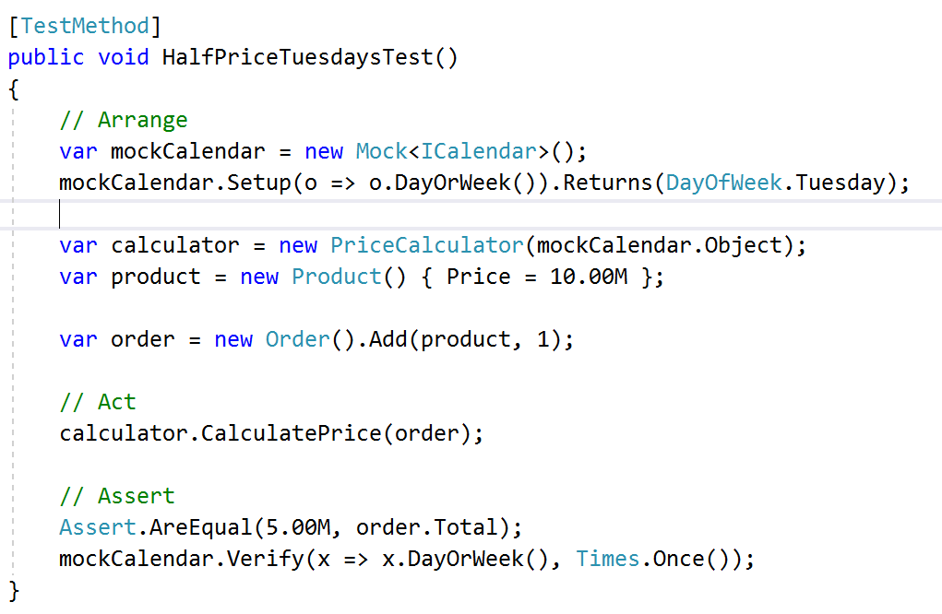
Mock Example
Notes:
Black = Don’t know internals , White = Know internals
Testing Internals is generally Bad. I don’t care that DayOfWeek was called once.
“I really like the fact that while writing the test you focus on the result of the behavior, not how it's done. ” – Martin Fowler
So mocks are a third party library that implements the methods you request. I actually don’t know how they do it, ExpandoObject? I should really know but I tend to stick in the strongly typed world of .Net and avoid this kind of stuff.
So I am not a fan of mocks for one reason, people tend to end up using them to verify that the dependent object was called which to me is a bit of a smell. I like to focus on the inputs and outputs of the object you are testing. So does Martin Fowler so that’s nice.
“I really like the fact that while writing the test you focus on the result of the behavior, not how it's done. ” – Martin Fowler

Slide 30
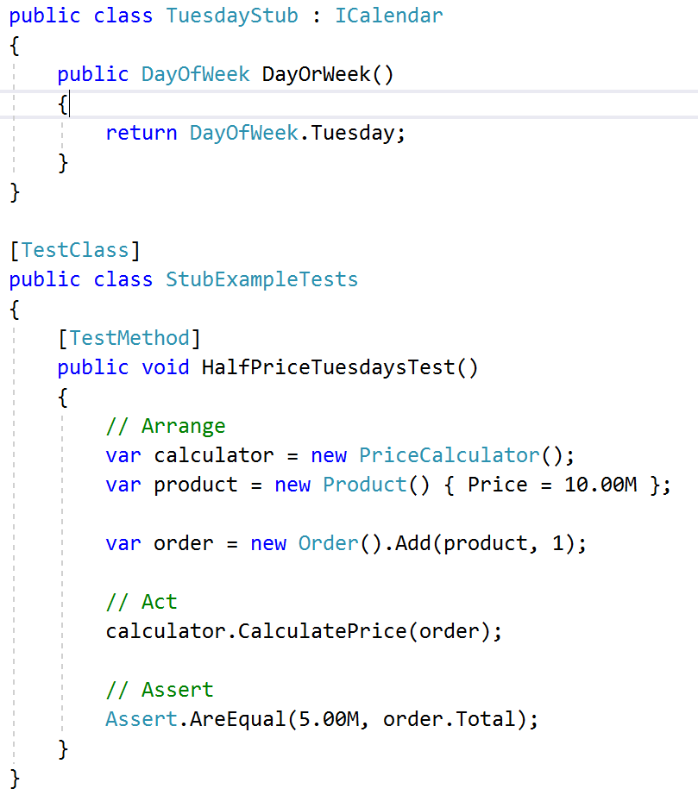
Stub Example
Notes:
I Like Stubs | Define an output | Go With It
I like stubs, they are simple (as long as you keep them simple) and it’s harder to fall into the trap of testing anything past the external interfaces of your object under test.

Slide 31
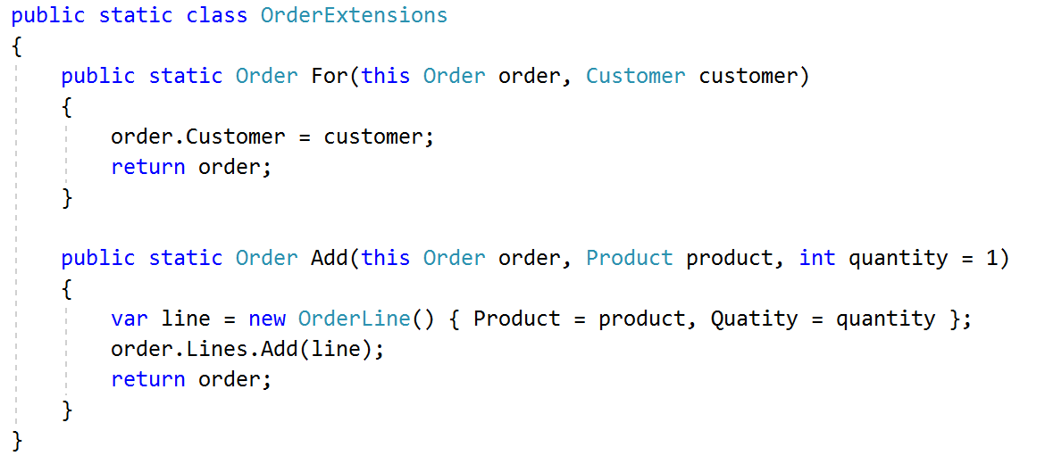
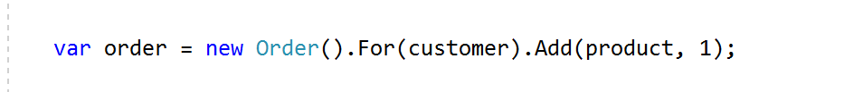
Fluid Extensions
Keep your tests simple. KISS
Fluid can help with this.
Notes:
8 year old
I previously mentioned tests should look like your trying to tell a story to an 8 year old. One way to help achieve that is to use Fluid Extensions.
I tend to use them in the test setup and you can almost write sentences using this approach.

Slide 32
In Memory Database
Something that came out in entity framework .Net core
Bit of a game changer
Don’t Test CRUD
Test driven implementation of Searching, Filtering, Ordering and Pagination.
https://github.com/JoelViney/CorePaginationExample
Jason Taylor’s Presentation on the InMemory Provider
https://www.youtube.com/watch?v=UON5Rr_CL2M
Notes:
.Net Core added InMemory Database
Game Changer – I used it in the Payroll system
Don’t Test Crud
Pagination Example
Jason Taylor – 20 Minutes
Time Limitations
So .Net core added the InMemory database and to be honest I am astounded it hasn’t got more attention, it’s a bit of a game changer.
That said, don’t fall into the trap of testing crud, it’s fragile.
I’ve linked a simple example that implements searching, filtering ordering and pagination. It’s also at the end of the slide.
Jason Taylor has also done a brief 20 minute presentation on using it which is worth watching.
Because of time limitations I won’t go into detail on this

Slide 33
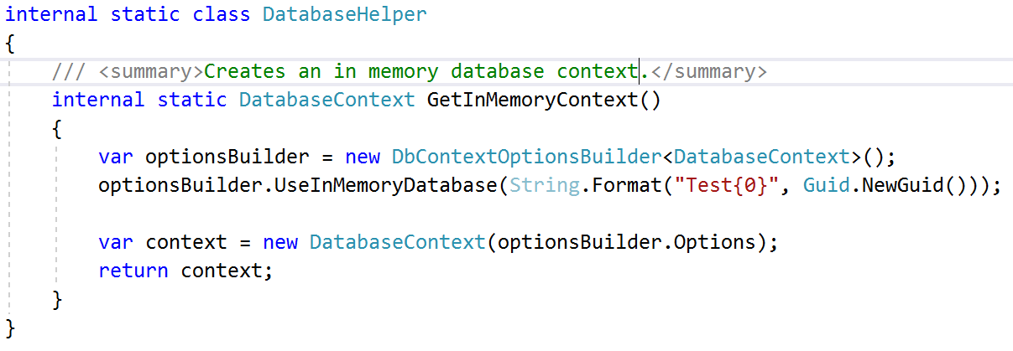
In Memory Database - Setup
Install-Package Microsoft.EntityFrameworkCore.InMemory
Notes:
Example of creating the in memory context.
SO this is an example of creating the in memory database context. It’s pretty self explanatory.

Slide 34
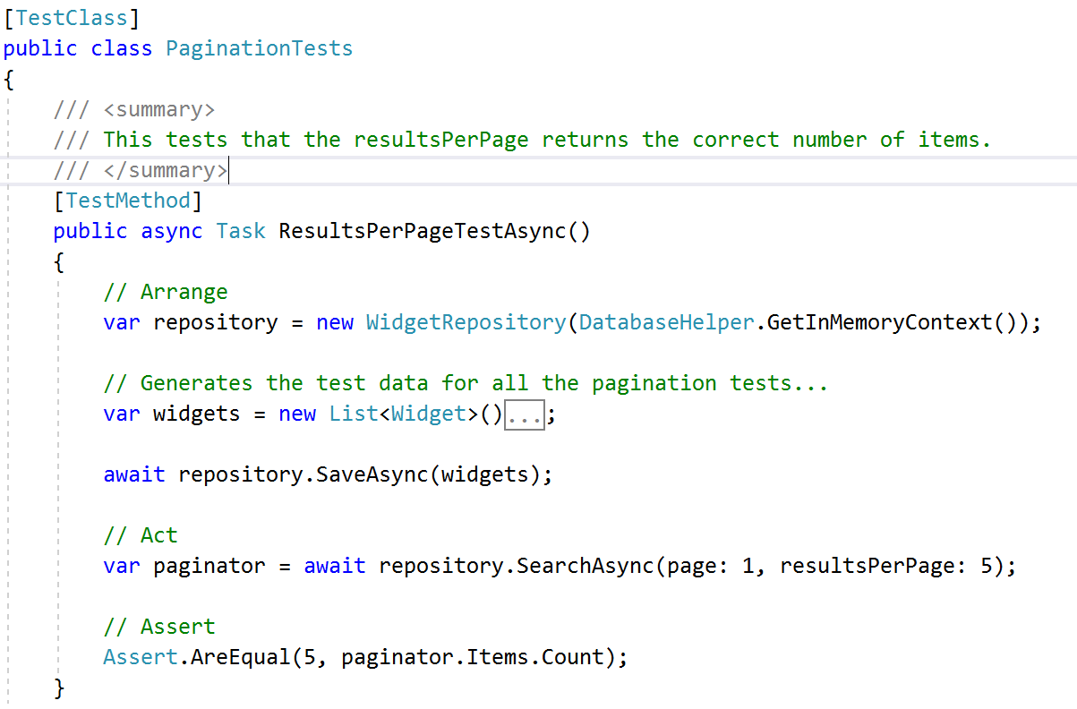
In Memory Database - Test
Notes:
Test that the Paginator Paginates.
Go through the code… Widgets adds a bunch of widgets…
So then here is a simple example of using it. Passing in the in memory context to the concrete repository. Creating some widgets, then searching for them and assuring we get the number back that we requested. Simple but it proves the paginator paginates.

Slide 35
But, how do I learn TDD?
Ironically start with an integration test.
That could use local file system or azure storage.
Get the hang of writing tests.
Try to keep your tests short… (e.g. 10 lines of code or less).
Find a complex problem, TDD it.
Notes:
Integration Tests = Easy to Understand, Simple to Interface out.
Test Create Folder, Save File etc… Not business logic e.g. Resize Image, Save To Folder
Complex Problem –
Price / Order Calculators
HR -> Process Shifts -> Payslip -> Process Bank File
Alert / Notification Systems
Workflows (Bug Tracking, Requestioning Approval)
Queue Systems
Importing Files (Xml, Json, CSV)
Validation Systems
Authentication Processes
Flight Booking – Traveling Salesman Problem
Expert Systems
Trying to teach juniors to learn test driven I tend to start with something really simple, where they know the solution and in theory can write tests that explain it simply. For example interfacing out your local file system implementation. Doing this also means when you have other tests that need the local file system you have a nice clean and tidy interface to it that you can then implement with mocks or stubs.
A word of warning, write the interface to the file system, e.g. Create Folder, Save File. Don’t implement your business logic e.g. I need to resize and image and save it to a specific folder, that’s another layer of tests.
Some examples of where I have used Unit Tests in my career are:
Price / Order Calculators
HR -> Process Shifts -> Payslip -> Process Bank File
Alert / Notification Systems
Workflows (Bug Tracking, Requestioning Approval)
Queue Systems
Importing Files (Xml, Json, CSV)
Validation Systems
Authentication Processes
Flight Booking – Traveling Salesman Problem
Expert Systems
Look for these kind of complex problems within the applications you are writing. They should have some complex business logic in them, they should be easy to isolate so you can define the boundaries of your tests. They can be dependant on other libraries or integrations, but you should be able to mock or stub them out.

Slide 36
Summary
Different Types of Tests
How to do test driven development
Best Practice / Pitfalls
Emergent Design
Mocks and Stubs
Telling a story using Fluid Extensions
In-memory Database
Notes:
Verbatim
Low hanging fruit
Emergent Design = You need to do it, cant learn it from watching slides.
This is what we have covered and I would hope by the end of this you can start to see the approach that I take to test driven development. I don’t use it as a golden hammer, I pick the low hanging fruit and leverage it to solve complex business problems. I think this is where test driven really shines and should be added to every developers toolbox.
Emergent design is a big one, and something that has to be done, it can’t really be shown effectively. You need to get in there and start writing code.

Slide 37
Thank you!
This Presentation
https://github.com/JoelViney/TestDrivenTalk
Kent Beck – TDD By Example
Google it, it’s a free PDF
Kent Beck – Test Desiderata (YouTube)
https://www.youtube.com/watch?v=5LOdKDqdWYU&list=PLlmVY7qtgT_lkbrk9iZNizp978mVzpBKl
Example TDD Project
https://github.com/JoelViney/SimpleSharpTemplateEngine
In Memory Database:
https://github.com/JoelViney/CorePaginationExample
https://www.youtube.com/watch?v=UON5Rr_CL2M (Jason Taylor)
Notes:
Love TDD
Examples. Struggled, Start With Kent.
Verbatim
Thank You
QUESTIONS…
I love TDD and I hope that I showed that in this presentation.
Reading material. I would suggest starting with Kent Becks TDD by example. It’s a bit hard reading but there are some gems in there. I struggled to find material apart from that to be honest.
Wow, you read this far?
https://www.youtube.com/watch?v=T1XgFsitnQw

